Slide 1
Web order in EG POS
Updated 2023-08-10

Slide 2
Introduction
This document describes how to create sales orders in EG POS aka “Web orders”. Prepaid orders differs from “Customer orders” aka “Store local orders” in the matter of being prepaid and dispatched from another stock location. It also on high level describes how these orders are dispatched to picking locations and fulfilled to end user.
Key features
Uses nShift Ship for carrier delivery alternatives.
Supports “Pay and Collect” as delivery alternative.
Supports placing orders on items available in multiple stock locations.
Possible to set different rules on what items to make available for ordering.
Gift wrapping button on order line.
Supports members
Supports adding additional sales items that will be paid together with order items in one transaction.

Slide 3
Introduction
Both solutions
Supports creating sales orders on both registered customers and non-registered customers.
All existing «Customer Order» aka «Local store order» functionality is available for registered customers.
  Offers
  Customer group discounts
  ++
Supports members and member discounts.
Supports all available tender types.

Slide 4
Requirements
EG POS 4.0.0.012805 or above
Chain Web 2.10.250 or above
  As Customer master and customer order master
  With global customer order numbers
Either
  Chain Classic 2.1.1.0 patch 25 or above
  Or ItemService and InventoryService in EG Cloud
DispatchService
FileService
StoreService
nShift Ship account for carriers and shipping calculation

Slide 5
Demo

Slide 6
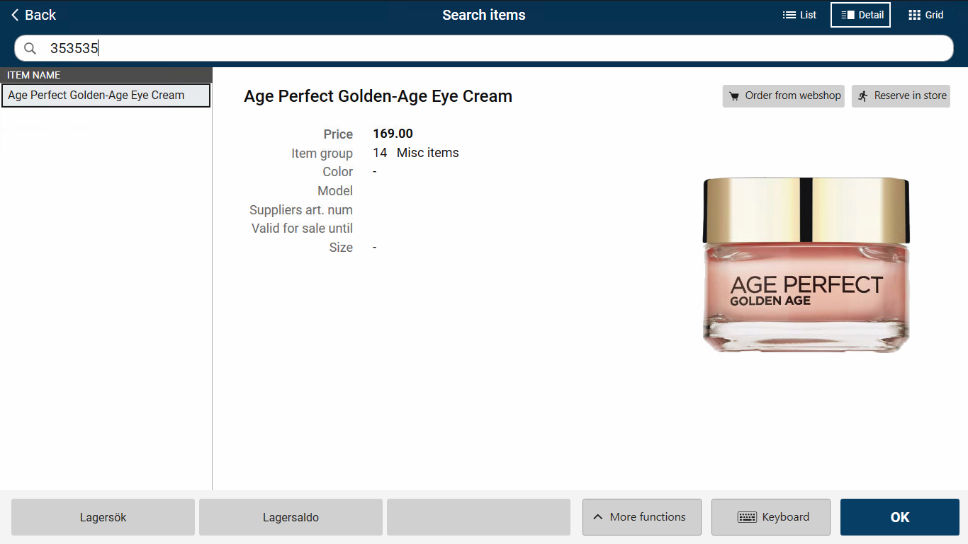
Demo Webordre EG POS
Employee starts by searching for an item.
If item is available for ordering, the button «Order from webshop» is visible.*
If item is available for ordering, this button appears on the item detail page
* What stock locations to include is configured in Chain Web “Dispatch Rules”. It can be one or multiple locations.
Notes:
Så, nå begynner salgsordrene og strømme inn fra [1] tradisjonell e-handel og [2] apper.
Enten integrert helt eller delvis med vårt omnikanale POSAPI, eller som ferdige ordrer som sendes inn til oss.
Det strømmer selvsagt også inn med ordrer fra butikkene via [3] EG POS og fra EG Mobile POS.
Nå passer det bra å vise hvordan vi gjør dette i EG POS kassen og i EG Mobile POS.
Hvordan man handler på nettet regner jeg med at ikke trenger noen demonstrasjon.

Slide 7
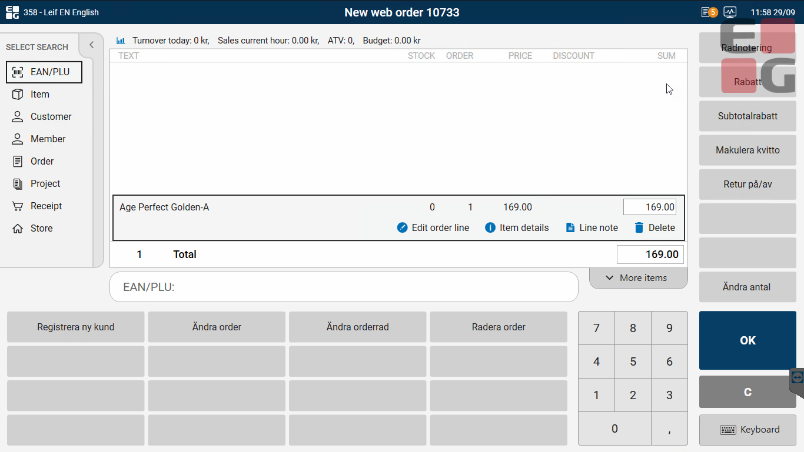
Demo Webordre EG POS
Item is added to a new web order.
To add another item to the order, search for another it and add it the same way as in the previous step.

Slide 8
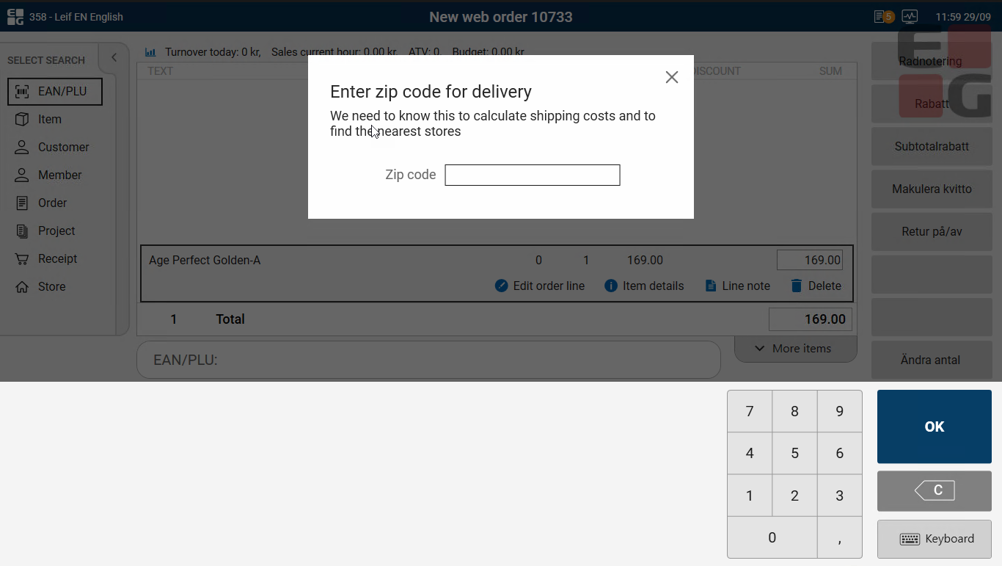
Demo Webordre EG POS
When finished adding items, click «OK» and you will be asked to enter a Zip code.
This is used to receive available freight alternatives and price from EG Dispatch Service and nShift.

Slide 9
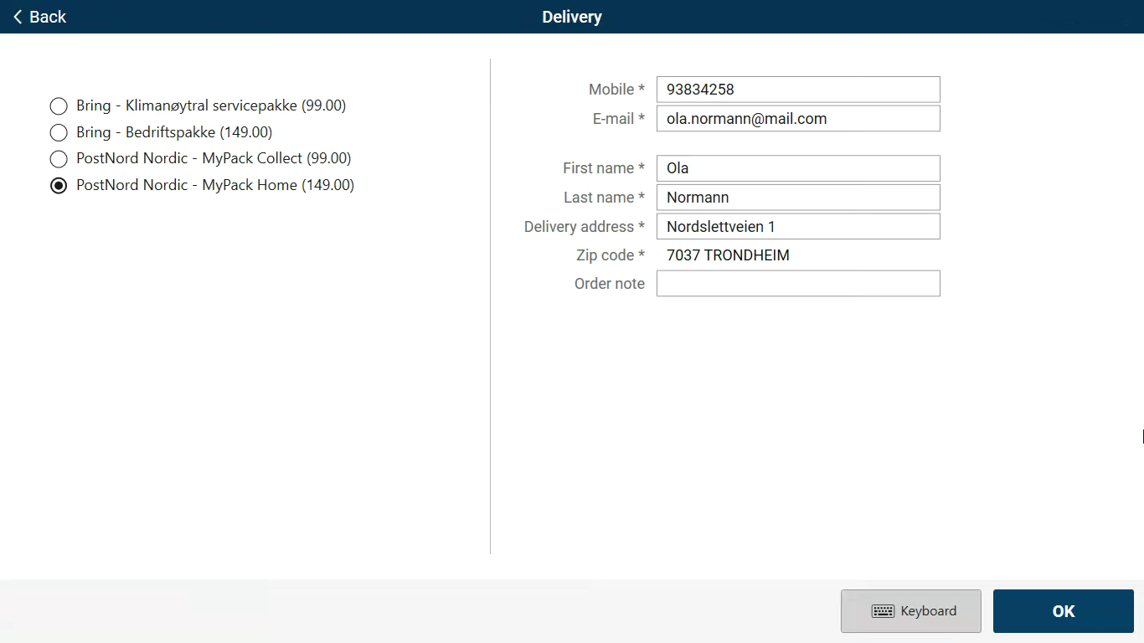
Demo Webordre EG POS
Gets the available delivery alternatives back from nShift/EG Dispatch Service
Selects the desired delivery alternative and completes delivery information.
If customer is a member, the member is added and delivery information is fetched from member details after entering mobile number.
If customer is not a member and there is a Bisnode integration present, information is fetched after entering mobile number. And register new member dialogue is shown.*
* Roadmap 2023

Slide 10
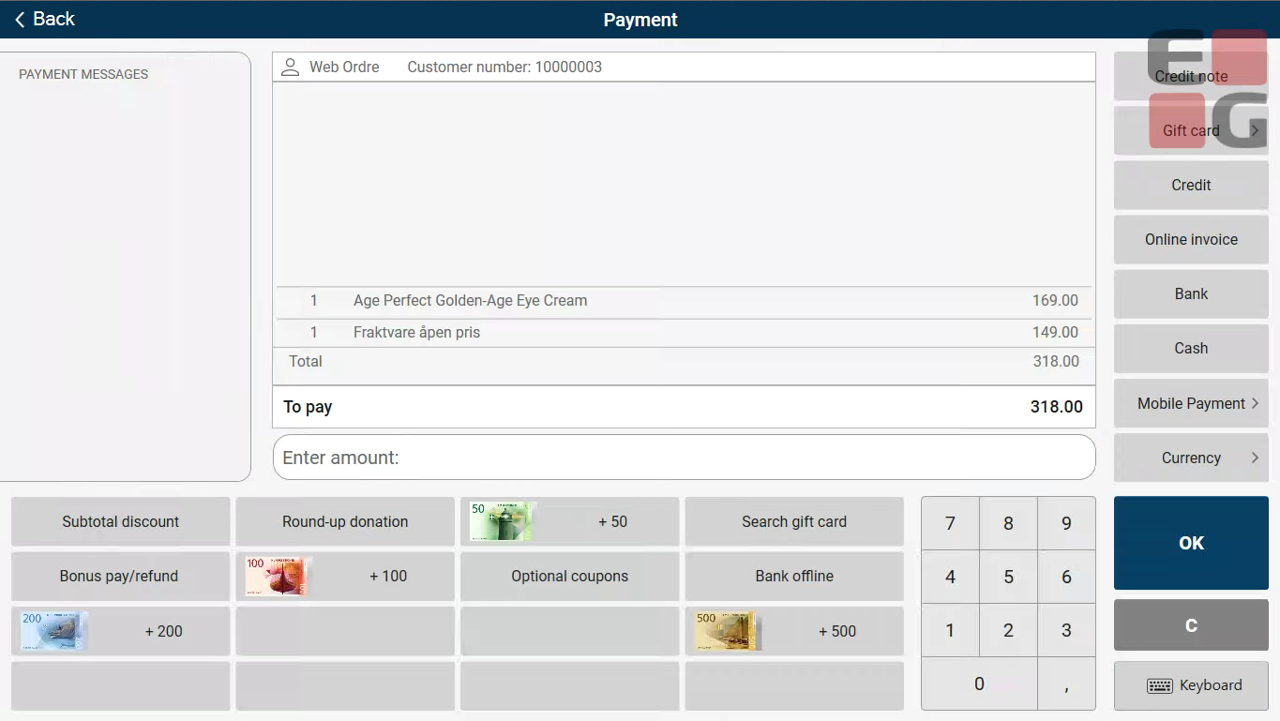
Demo Webordre EG POS
Order can now be paid.
However, if the customer also wants to take something home right away, this is also possible before payment is done.
Press «C» or Escape to go back to the sales view.

Slide 11
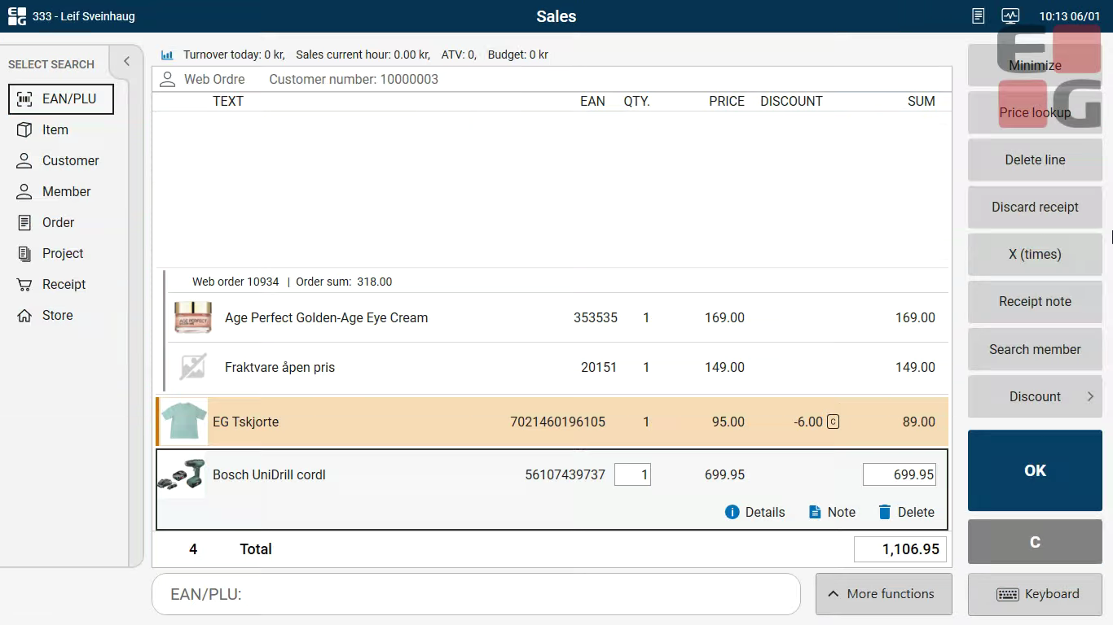
Demo Webordre EG POS
Back in the sales view other items can now be added outside the order as normal sale.
When all items are added enter the payment view again.

Slide 12

Demo Webordre EG POS
All items from the order and the sale are paid together in one transaction.
All tender types that is set up in the store is available.
However, only Klarna will support “reserve” transaction*. All others will be “capture”.
The order and orderliness are sent to EG Order Dispatch module and will be dispatched based on the dispatch rules set (Stock locations, stock adjustments and so on)
* Roadmap 2023

Slide 13
Diagrams

Slide 14
1. Create weborder
Trans-
porters
2a: Create order cart in webshop and send finished JSON order file to EG FileService
EG
FileService
EG
BatchTo
Posapi
3a: Creates order poslog
EG POS API
EG OMS
1ab: Carriers from nShift
or other TMS
nShift
DeliveryHub
Webshop
2b: Create order poslog with EG ItemSale
4abc: Order into EG OMS
EG DispatchService
EG Mobile
2c: Create order poslog with EG ItemSale
1cd: Carriers from nShift.
Delivery Suggestions from DispatchService
EG POS
2d: Create order poslog in EG POS and send to EG OMS

Slide 15
2. Dispatch orders
1. Dispatch suggestion
EG DispatchService
EG OMS
- Dispatching picking orders
WMS
Central Warehouse
Pickingorder
3a Export EG PickingOrder on JSON format to 3.party WMS
Store
Pickingorder
3b. Pickingorders
to stores
(EG InStore APP)
Store
Pickingorder
2. Item stock reserved on selected picking location
EG Inventory/
Chain Classic
Supplier
(Drop ship Roadmap Q1 2023)

Slide 16
3. Pick, book and print
1a: Central Warehouse book and print shipments and labels with nShift or (any TMS) directly
1b: Central Warehouse book and print nShift shipment and labels with EG InStore App
Nshift
EG DispatchService
EG OMS
- Picking
- Packing
Central Warehouse
Picking
Packing
2: Picking locations update
status of picking back to EG OMS
Store
Picking
Packing
Store
Picking
Packing
1c: Stores book and print nShift shipment
and labels with EG InStore App
Item stock reduced on picking location. Internal transfer from «selling store» to «picking store»
EG Inventory/Chain Classic

Slide 17
4. Stock movements
Order placed on store X
Order picked on store Y
Item A in order
Item A in order
Chain Classic stock on item A in store X after order placement:
0 in physical stock → 0 in physical stock
0 in available stock → -1 in available stock
Chain Classic stock on item A in store Y after picking:
1 in physical stock → 0 in physical stock
1 in available stock → 1 in available stock
After order is registered as picked in EG OMS,
an internal transfer is automatically registered to correct stock values
Chain Classic stock on item A in store X after internal transfer:
0 in physical stock → 0 in physical stock
0 in available stock → 0 in available stock
Chain Classic stock on item A in store Y after internal transfer:
1 in physical stock → 0 in physical stock
1 in available stock → 0 in available stock
Internal
transfer

Slide 18
5. Return/Refund
Return items to webshop
Return items in physical store
Customer
Customer
Send items to web shop
Bring item to store
EG OMS
Employee
Return items in order
Search for order and use «validated return» to select item to return
POS API
EG POS
Klarna payment refund
Default refund against Klarna but selection of other tender type is possible
Klarna
Klarna

