Slide 1
EG E-com integration
Last changed 2023-03-28

Slide 2
To do
Legg til use case’er i begynnelsen: Hvilke prosesser kan vi løse med våre api?
Lag diagrammer med POSAPI’et (I dag er det bare for Order JSON).

Slide 3
Customer journeys

Slide 4
Background
This document describes the different ways to integrate against the EG API from a third-party E-com for creating sales orders. This kind of e-com sales order is often also referred to as a “weborder” in EG documentation.
The document is a supplement to the swagger documentation found here: https://posapi.egretail.cloud/swagger/index.html

Slide 5
Table of contents
Overview omni services
The two types of integrations
  EG API Cart (REST)
  EG Order JSON
Authentication to EG Services
Sales order characteristics
Delivery alternatives
Payment
Return
Sales order types and flows
Synchronize data to e-com

Slide 6





An Omni-channel Solution
Providing the same customer experience in all sales channels
Standard solution
Benefit from some of the largest retailers in the Nordics
Modern architecture equipped for the future
Open APIs
Store data
Customer club
Items and prices
Logistics
EG Self checkout
Promotions
Mobile POS
eCommerce
EG POS
Notes:
eCommerce og onlie sites inngår i EG sin omnikanale løsning på samme sett som våre egne salgs kanaler, fysiske kasse og mobile eneheter

Slide 7
Omni-channel Solution
Cloud first & API first
EG Mobile POS
Cloud POS
EG Chain
Cloud modules
3. party back end
3. party front-end
EG Cloud API
Integration Platform / Azure Service Bus
EG POS
EG platform
Virtual Machines (OnPrem)
EG Chain
EG Loyalty
Notes:
Skalerer og leverer ytelse etter behov
Raskere tilgang til ny funksjonalitet
Bedre overvåkning og verktøy for drift av løsninger
Bedre sikkerhet
Alltid tilgjengelig
Bedre samarbeid mellom løsningsleverandører
Mindre fokus på hardware gir mer fokus på løsninger og nytteverdi
Kostnadseffektivt

Slide 8
Omni-channel Solution
Cloud first & API first
EG Mobile POS
Cloud POS
EG Chain
Cloud modules
3. party back end
3. party front-end
GiftCardService
Digital gift cards
PaymentService
Payment
POS API
Virtual POS (cart)
POS API Data Sync
Items /prices /campaigns
StoreService
Store info
DispatchService
Stock / Order dispatch
Loyalty Services
ReceiptService
Digital receipts
EG Integration Platform
Azure Service Bus
EG POS
EG platform
Virtual Machines (OnPrem)
EG Chain
CouponService
Digital coupons
StampCardService
Digital stamp cards
EG Loyalty
MemberInfoService
Create/get member

Slide 9
Two types of integration
There are two ways to integrate against the EG API for creating sales orders:
Using our REST API to create a cart.
Or sending us a JSON file with the order.

Slide 10
EG POS API Cart
EG API Cart
Synchronous integration with EG POS API (Rest API).
The cart is created and handled with a virtual POS (POSAPI) directly and all price calculation is done in API on the fly.
Use all the same item and price data, the same price engine, and the same price rules as POS in physical stores.
In both integrations, the sales order ends up in EG Order Management System (EG OMS) and can be dispatched to the warehouse and/or stores for picking and fulfillment. (Dispatching can also be handled by another part).
And in both ways a receipt is created and enters the normal flow along with the receipts from all the other physical EG POS.

Slide 11
EG API Cart
The e-commerce platform maintains the user's session data by assigning an EG CartId to any new shopping cart that is created. When the user performs actions that add or remove items from the shopping cart, this information is sent to EG with the associated CartId.
EG then generates an updated shopping cart response that includes calculated prices and discounts, which can be displayed immediately on the online store's shopping cart. This enables a seamless and efficient trading process for users.

Slide 12

EG API Cart
E-com
Delivery/Payment
3.party OMS/WMS
Frontend
Cart creation
EG API and Backoffice
Order JSON export. Status import
EG Item, Price, Promotion
EG POSAPI
Cart*
Order creation
EG OMS
(Dispatching, order picking, customer service)
Click and Collect
Home delivery
Delivery/Payment
* More details about the EG POSAPI here

Slide 13
EG POS API Cart
E-com and EG Mobile POS
Frontend
Backend
EG API and Backend
EG Item, Price, Promotion
EG POSAPI
Cart*
EG OMS
EG POS and Mobile
Cart
* More details about the EG POSAPI here
Notes:
Synchronous integration with EG API (Rest API).
The cart is created and handled with a virtual POS (POSAPI) directly and all price calculation is done in API on the fly.
Use all the same item and price data, the same price engine, and the same price rules as POS in physical stores.
In both integrations, the sales order ends up in EG Order Management System (EG OMS) and can be dispatched to the warehouse and/or stores for picking and fulfillment. (Dispatching can also be handled by another part).
And in both ways a receipt is created and enters the normal flow along with the receipts from all the other physical EG POS.
The e-commerce platform maintains the user's session data by assigning an EG CartId to any new shopping cart that is created. When the user performs actions that add or remove items from the shopping cart, this information is sent to EG with the associated CartId.
EG then generates an updated shopping cart response that includes calculated prices and discounts, which can be displayed immediately on the online store's shopping cart. This enables a seamless and efficient trading process for users.

Slide 14
Example of cart requests
Cart creation example
This examples shows the basic requests needed to create a cart for online orders and can be used as a starting point for testing the API.
The APIKey set in NewCartWithItems, together with an optional store number, determines which store and virtual POS the Cart is created for. Each virtual POS can have its own configuration to toggle features and behaviors and can be allocated to different countries for localization. We currently support these languages for localized texts: Danish, German, English, Estonian, Finnish, Norwegian, Swedish.
Create cart
api/ItemSale/NewCartWithItems
api/ItemSale/AddItemToCart
api/ItemSale/CheckoutCart
Delivery and payment
api/ItemSale/BeginCartEditing
api/ItemSale/DeliverCartItem, once per line to deliver
api/ItemSale/AddPaymentToCart2
api/ItemSale/EndCartEditing
Return
api/ItemSale/NewCartWithItemReturn
api/ItemSale/AddPaymentToCart2
api/ItemSale/CheckoutCart

Slide 15
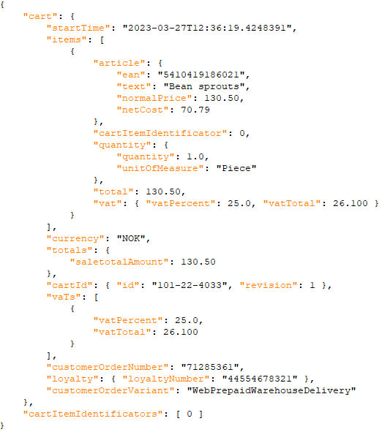
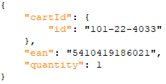
Example of cart requests
Example request
AddItemToCart
Example response (simplified)

Slide 16
Order JSON file
EG Order JSON file
Asynchronous integration with EG.
Cart is created at 3.party system and a complete sales order is sent to EG on an Order JSON format via EG File Service.
Frontend can either
  Do all cart calculation in existing 3.party system and send a complete order to EG.
  Utilize the POSAPI CartCalculator to calculate the cart before sending the order to EG.
    Ensures same price as physical stores on all items, and some of the same price rules as in store available.
      For more complex price rules, EG API Cart integration is needed.

Slide 17
Order JSON file
E-com
Frontend
Cart
EG Order
JSON file (2)
EG API and Backend
EG Item,Price, Promotion
EG POSAPI
CartCalculator (1)
EG FileService
EG OMS
EG POS
Cart
(1).Optional cart calculator. (2). More details on the EG Order JSON file and EG POSAPI CartCalculator here
Notes:
Asynchronous integration with EG.
Cart is created at 3.party system and a complete sales order is sent to EG on an Order JSON format via EG File Service.
Frontend can either
Do all cart calculation in existing 3.party system and send a complete order to EG.
Utilize the POSAPI CartCalculator to calculate the cart before sending the order to EG.
Ensures same price as physical stores on all items, and some of the same price rules as in store available.
For more complex price rules, EG API Cart integration is needed.

Slide 18
Example of an Order JSON
Look at the Swagger documents for an example of the EG Order JSON:
Order: https://posapi.egretail.cloud/swagger/index.html#/Order/post_api_Order_queue_Complete
Delivery: https://posapi.egretail.cloud/swagger/index.html#/Order/post_api_Order_queue_Delivery
Payment: https://posapi.egretail.cloud/swagger/index.html#/Order/post_api_Order_queue_Payment

Slide 19
EG API Client Authentication
All EG services use client-certificates for authentication. The certificate is used to get an access_token from Azure Active Directory (AAD). This access_token is then used with the service, until the access_token expires.
Technical background:
Azure AD uses a proposed extension to the OAuth standard (described here) that allows the client to authenticate using a certificate. This is done by creating a "client_assertion" which is a JsonWebToken (JWT) which has been signed by the certificate. The process is described here and here and here. However most/all programming languages have some/good support for this process.
Access_token caching:
Caching the access_token is REQUIRED. When you re-use the access_token, your integration will continue to work well even if the authentication service (Azure AD) is slow/unavailable. It will also make the integration faster since there will be only one network call (and not two). Most authentication libraries do this caching automatically, but make sure it works. Also make sure you avoid doing requests with an expired access_token, check it validity before making the request.
Certificate management:
All certificates eventually expire, and it is the client's (i.e. your) responsibility to request to enroll a new certificate well before it expires. Your client application should support having multiple certificates, to support rolling over to the new certificate without interruption. Certificates are (on Windows) stored in the User or Machine certificate store.

Slide 20
EG API Client Authentication
Credentials creation workflow:
You request access to one or more of EG services. In the request, include the following:
  A confirmation that you have read and agreed to EG integration agreement
  Which retail chain you are representing
  Which environment you need access to (DEV, TEST or PROD)
  The name and email of at least one technical contact person
  The full URL of each service endpoint you want access to
    If you do not know which services/endpoints you need, please contact EG.
    Please make yourself acquainted with the service documentation to ensure the service is correct for your use case.
    EG need the list of endpoints to ensure you have the correct access permissions
EG will create a new client-definition for you, and give you the following:
  Your ClientID (A GUID)
  The AAD URL where you will authenticate with the certificate and get your access_token
You will create the client certificate (using the ClientID) and send EG the public key (NOT the private key).
  Click here see how.
EG will confirm that the public key has been received and that you have been granted access.
You will verify your credentials by:
  Using the private key to get an access_token from AAD (see below for sample code)
  Using the access_token to make a request to the service endpoints
  Notifying EG that access works

Slide 21
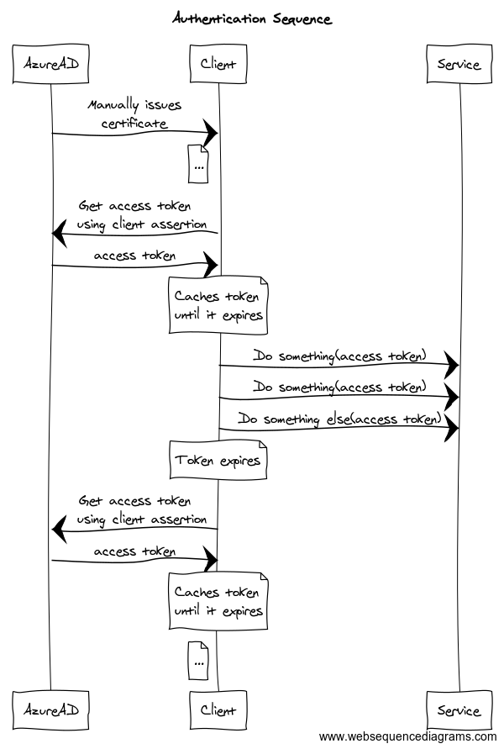
EG API Client Authentication
Technical details:
C# Code samples
PHP Code samples
Client credential generation
Using Postman to authenticate
An overview of all EG API services

Slide 22
EG API Client Authentication
OAuth with client certificate
Same authentication model as other EG API’s
More details and code examples:
EG API authentication

Slide 23
Upload order to EG File Service
Client = System that wants to deliver a file for import into EG systems.
Client delivers files of data to EG using FileService.
  This means that even if ServiceX needs the data, you still deliver the file to FileService.
The file is defined by it's fileType and contract, as defined by the service that "owns" that fileType/contract.
In addition to the file itself, the client can specify some custom properties.
Client will get a unique fileId from FileService, that can be used for troubleshooting and tracking the file import progress.
  One or more of EG services might listen for a given filetype
  Services might update the file status in FileService, and might export a new file with processing status of each row in the file.
How to format files

Slide 24
Different sales order characteristics
Customer
  The order can be on a registered customer or a nonregistered customer.
  Delivery information is separated from the customer information.
Payment (see separate slide for more details)
  An order can be prepaid
    Supports payment “reservation” on some tender types.
    Payment “capture” can be done later upon picking.
  An order can also be reserved in a store only
    Will not have a payment reference at all.
    Also known as “Click and Collect – Reserve in store” .
Delivery (see separate slide for more details)
  Delivery via carriers
  Collected at store
    Prepaid orders also known as “Click and Collect – Pay and Collect”.
    Reserved orders, “Click and Collect – Reserve in store” as mentioned above.
Return
  Can be done in physical stores or webshop.

Slide 25
Delivery alternatives
Delivery alternatives
EG POS and Mobile use EG DispatchService for presenting delivery alternatives and calculated freight price on carts.
  Carriers and products are fetched from the customers nShift agrement.
  Pay and collect and reserve and collect are configured in EG DispatchService.
Webshop frontend can use whatever freight integration they want, as long as the same delivery alternatives, carriers and products are available in EG DispatchService/nShift.

Slide 26
Payment
Orders placed on E-com or other 3.party solution
Orders can be created on any given store. Each store can have their own payment merchant id. This way, the turnover can be placed directly on any store.
  For a web shop, this means that the orders are typically placed on the web shop store with the web shop merchant id.
  For a sales kiosk in a physical store, or a scan and pay app, the orders can be created on the physical store number with the stores’ merchant id.
E-com can handle both reservation and capture of payment. When EG is picking, EG will provide order status updates pr order line and pr order to E-com for capture.
Or EG can do the capture directly when orders are picked with EG POS or EG InStore App and the provider is Klarna.
Orders placed in EG POS and EG Mobile
Turnover will go to the store where the order is placed.
Sale orders supports all configured tender types in POS. As for now, only Klarna is planned to use «reserve» payment. Rest is «capture». However, we can support «reserve» on any payment provider with a web-based API.

Slide 27
Return/Refund
Return items to web shop warehouse
Return items in physical store
Customer
Customer
Send items to web shop warehouse
Bring item to store
EG OMS
Employe
Return items in order
Search for order and use «validated return» to select item to return
POS API
EG POS
Klarna payment refund
Default refund against Klarna but selection of other tender type is possible
Klarna
Klarna
Notes:
Eller så kan web shop gjøre Klarna refund basert på ordrestatus

Slide 28
Diagrams

Slide 29
Sales order types and flows
The following pages describes the most common order flows. In the examples, EG OMS is the master for orders and handles capture of payment.
Prepaid, shipped orders.
  Orders that are paid (payment reserved) and will be shipped from a stock location with a selected carrier.
Prepaid, collect at store orders («Pay and Collect»)
  Orders that are paid and collected at selected store.
Reserved, collect at store orders («Reserve and Collect»)
  Orders that are not prepaid but collected and paid at selected store.

Slide 30
Sales order types and flows
The following pages describes the most common order flows. In the examples an EG Order JSON is uploaded, but the flows are the same from EG POSAPI when using EG for cart creation directly. In the examples, EG OMS is the master for orders.
Prepaid, shipped orders.
  Orders that are paid (payment reserved) and will be shipped from a stock location with a selected carrier.
Prepaid, collect at store orders («Pay and Collect»)
  Orders that are paid and collected at selected store.
Reserved, collect at store orders («Reserve and Collect»)
  Orders that are not prepaid but collected and paid at selected store.

Slide 31
Order JSON
Ready calculated cart sent to FileService

Slide 32

Prepaid, shipped orders
Customer
E-com
EG
Payment provider
Customer place an order and selects a carrier and carrier product
Uploads an order to EG API on EG JSON format with the delivery method as product name or id*
Picking order is sent to one or multiple stock locations. Picking is done. Shipment is booked and shipping label printed. Payment capture is done, and customer is notified.
E-com can fetch order status
e-com
EG Order
EG API
EG OMS
Capture payment*
Klarna
Reserve payment
EG OMS sends email and/or SMS to customer with status of the order.
*See https://posapi.egretail-test.cloud/swagger/index.html#/Order/post_api_Order_queue_Complete for full JSON example
Deliverymethod is set as a product name or an id to be used later on for «Book and Print» of shipping labels. Deliverypoint is for an optional drop point id.
*Optional. Capture can also be done by e-com. Details in the part about «Payment» earlier.
"deliveryDetails": { "method": «1234abc», "deliveryPointId": «123456789», "deliveryPointHours": null },
Notes:
Prepaid, shipped orders.
Orders that are paid (payment reserved) and will be shipped from a stock location with a selected carrier.

Slide 33
Prepaid, collect at store orders
“Pay and Collect”
Customer
E-com
EG
Payment provider
Customer place an order, pay the order and select a store to collect it from
Uploads an order to EG API on EG JSON format with delivery method «Pay and Collect»
and the store X to collect in.*
Picking order is sent straight to store X. Picking is done. Payment capture is done when customer collects order.
E-com can fetch order status
e-com
EG Order
EG API
EG OMS
EG POS
Capture payment*
Klarna
Reserve payment
EG POS sends SMS or email to customer.
«Order ready to collect». Customer collects order.
*See https://posapi.egretail-test.cloud/swagger/index.html#/Order/post_api_Order_queue_Complete for full JSON example
Deliverymethod for Pay and Collect is «pac» and «deliveryPointId» is the store number to collect in.
*Optional. Capture can also be done by e-com. Details in the part about «Payment» earlier.
"deliveryDetails": { "method": «pac", "deliveryPointId": «1", "deliveryPointHours": null },
Notes:
Prepaid, collect at store orders («Pay and Collect»)
Orders that are paid and collected at selected store.

Slide 34
Reserved, collect at store orders “Reserve and Collect”
Customer
E-com
EG
Payment provider
Customer place an order and selects a store to collect and pay it in
Uploads an order to EG API on EG JSON format with delivery method «Reserve in store»
and the store X to collect in.*
Picking order is sent straight to store X. Picking is done. Payment capture is done when customer collects order.
E-com can fetch order status
e-com
EG Order
EG API
EG OMS
EG POS
Capture payment*
All available tender types in store
EG POS sends SMS or email to customer.
«Order ready to collect». Customer collects order and pay it.
*See https://posapi.egretail-test.cloud/swagger/index.html#/Order/post_api_Order_queue_Complete for full JSON example
Deliverymethod for Pay and Collect is «LRS.RIS» and «deliveryPointId» is the store number to collect in.
"deliveryDetails": { "method": «LRS.RIS", "deliveryPointId": «1", "deliveryPointHours": null },
Notes:
Reserved, collect at store orders («Reserve and Collect»)
Orders that are not prepaid but collected and paid at selected store.

Slide 35
Order Rest API
Cart created with POSAPI

Slide 36
Prepaid, shipped orders
Customer
E-com
EG
Payment provider
Transport Management System
Customer place an order and selects a carrier and carrier product.
Create cart
api/ItemSale/NewCartWithItems
api/ItemSale/AddItemToCart
api/ItemSale/CheckoutCart
  Set delivery method
  <carrier product id>
Picking order is sent to one or multiple stock locations. Picking is done. Warehouses or stores.
Shipment is booked and shipping label printed. Payment capture is done, and customer is notified.
Capture can also be done by e-com. Details in the part about «Payment» earlier.
EG is integrated with nShift Ship. Warehouse can use nShift Ship or any other TMS they prefer.
EG OMS sends email and/or SMS to customer with status of the order.
e-com
1. Create cart
EG POSAPI
EG OMS
6. Capture payment
Klarna
nShift
2. Reserve payment
Carrier
Warehouse
3. Orders are sent to warehouse and/or store(s) for 4. picking and fulfilment
Any TMS
Store
5a. Order shipping and get shipping label back from nShift
5b. Order shipping and get shipping label back from TMS
7. Last mile from carrier to customer

Slide 37
Prepaid, collect at store orders
“Pay and Collect”
Customer
E-com
EG
Payment provider
Customer place an order and selects Pay and Collect delivery alternative.
Create cart
api/ItemSale/NewCartWithItems
api/ItemSale/AddItemToCart
api/ItemSale/CheckoutCart
  Set delivery method to <pac:storenumber>
Picking order is sent to the selected store. When it is picked the customer is notified.
Capture can also be done by e-com. Details in the part about «Payment» earlier.
4. EG OMS sends email and/or SMS to customer with status of the order.
e-com
1. Create cart
EG POSAPI
EG OMS
Klarna
2. Reserve payment
3. Store picks the order
5. Customer collects order
Store
6. Capture payment

Slide 38
Reserved, collect at store orders “Reserve and Collect”
Customer
E-com
EG
Payment provider
Customer place an order and selects to reserve items in store.
Create cart
api/ItemSale/NewCartWithItems
api/ItemSale/AddItemToCart
api/ItemSale/ReserveCartInStore
Picking order is sent to the selected store. When it is picked the customer is notified.
Payment is done by any means of tender supported in store.
3. EG OMS sends email and/or SMS to customer with status of the order.
e-com
1. Create cart
EG POSAPI
EG OMS
2. Store picks the order
4. Customer collects order and pays in store.
Store
Tender

Slide 39
Data synchronization

Slide 40
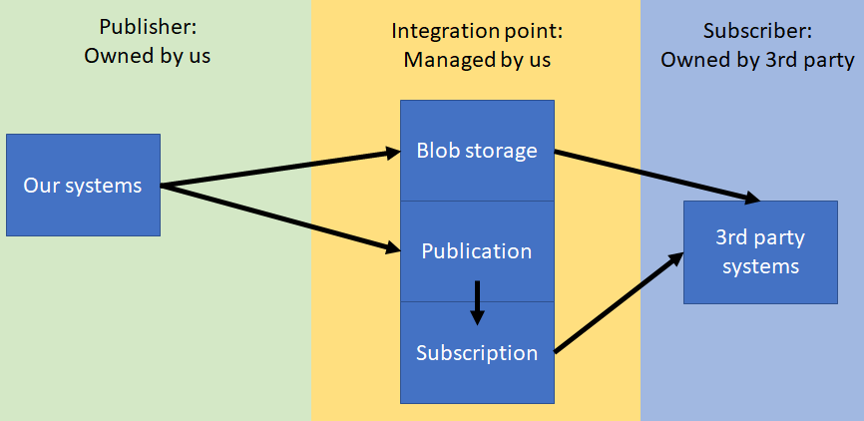
Synchronize data to e-com
Pub/Sub
Azure ServiceBus + Blob Storage
JSON format
Modified items/prices/promotions
More technical details and description of format

