Slide 1
Improving our API
Findings and Recommendations in the APIService
Johan Lange, EG Software
2025-10-15

Slide 2
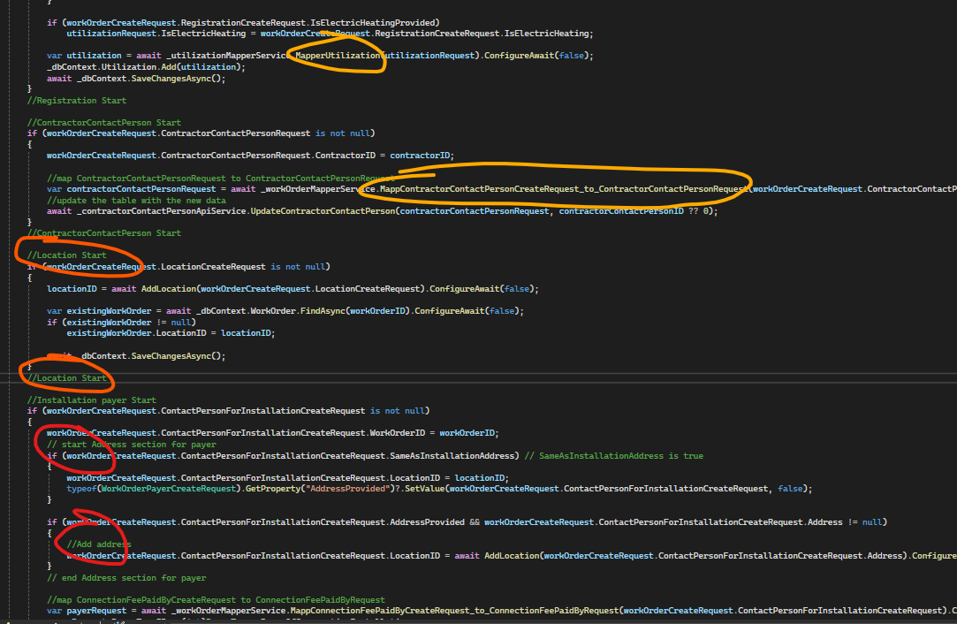
Readability
Long methods (700+ rows)
Long method names and classes
Inconsistent comments and descriptions
Deep nesting (too many if statements)
Typos

Slide 3

Readability – think of ☺
Split large methods into smaller (private) ones
1
Use clear, concise comments
3
Try avoiding typos
4
Use clear, descriptive method and variable names
2

Slide 4
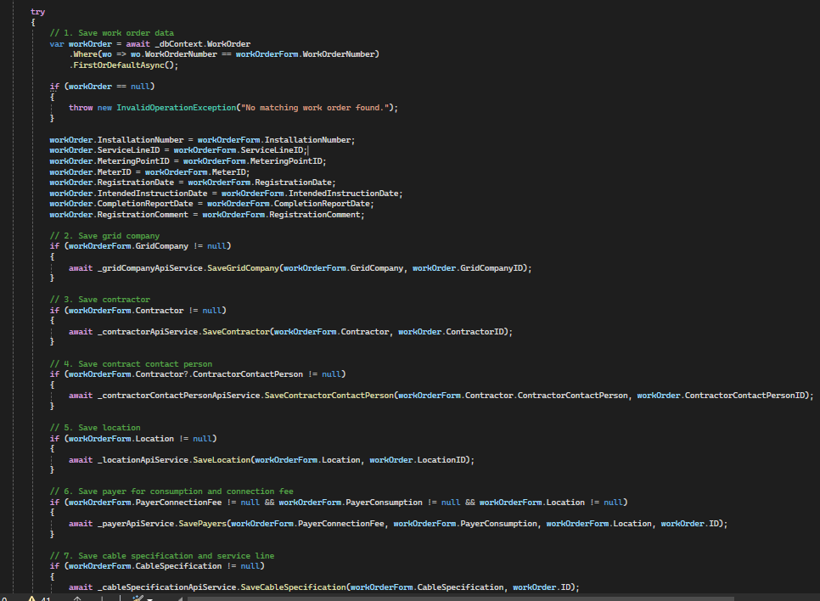
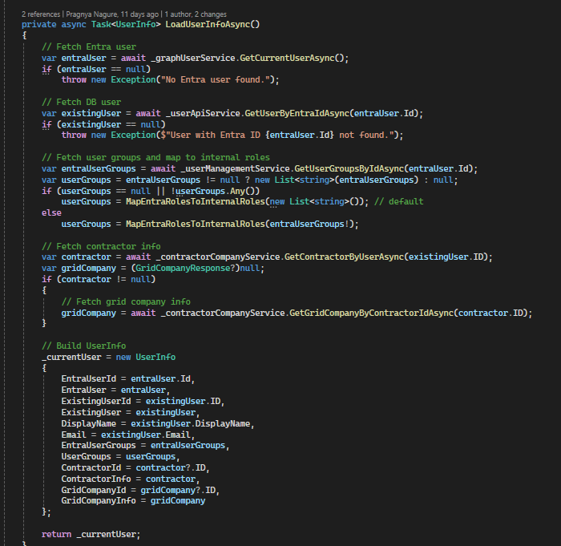
Examples
Break out logic
Less mappings
Concise comments

Slide 5
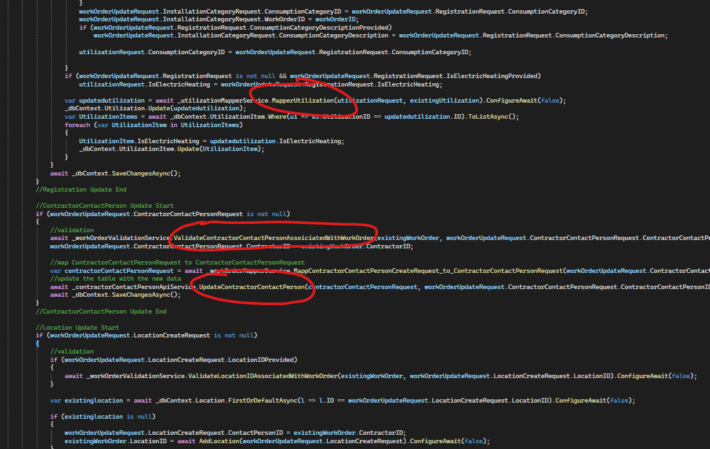
Mixed logic
Mixing validation, mapping and database logic in same method
Too much going on = hard to follow

Slide 6
Mixed logic – think of ☺
Separate logic into distinct layers for validation, mapping, and database operations.
1
Separate methods
Separate folders if necessary
2

Slide 7
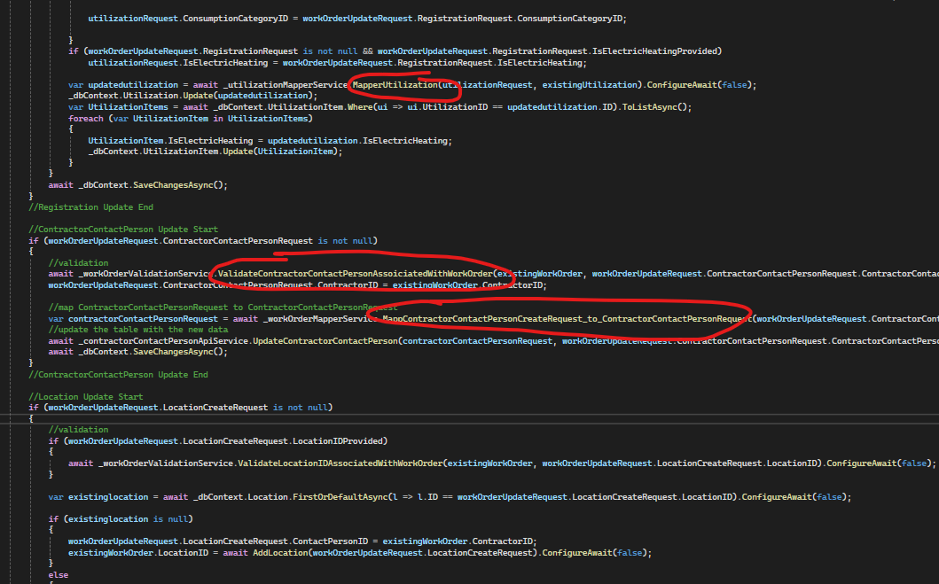
Method naming
Long method names
Long class names
Mixing naming conventions (Mapper vs Map)
Typos in method names (Mapp)
MappConnectionFeePaidByCreateRequest_to_ConnectionFeePaidByRequest = MapPayerConnectionFee()?

Slide 8
Method naming – think of ☺
Be consistent
1
Follow code conventions. PascalCase for methods, classes
2
Try avoid typos in method names
4
Clear verbs GetWorkOrder, UpdateCustomer etc.
3

Slide 9
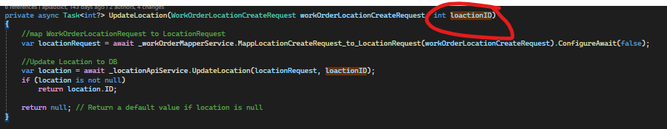
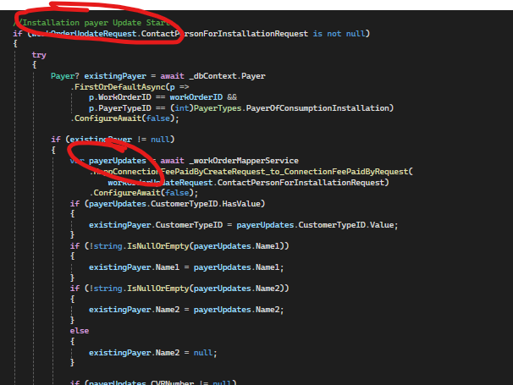
Variable naming
Long names
Inconsistent names
Misspelled variables

Slide 10
Variable naming – think of ☺
Be consistent, don’t mix
1
Follow coding conventions. Use camelCase for variables.
3
Keep names descriptive but concise
2

Slide 11
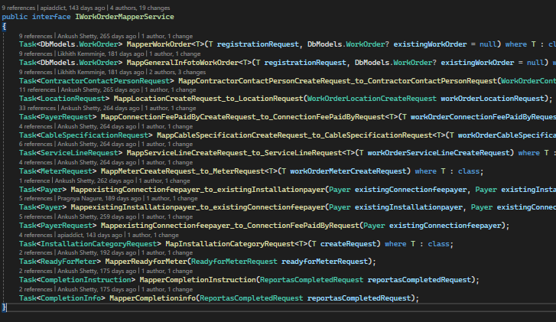
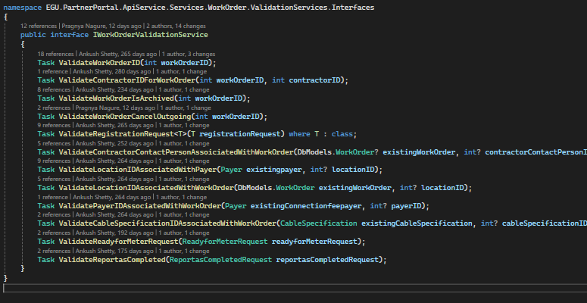
Unnecessary asyncs
Use async only when actual asynchronous work occurs (e.g., I/O, DB calls, HTTP requests).
Don’t make methods async when mapping, validations, calculations or setting variables.
Remove async when it isn’t needed.

Slide 12
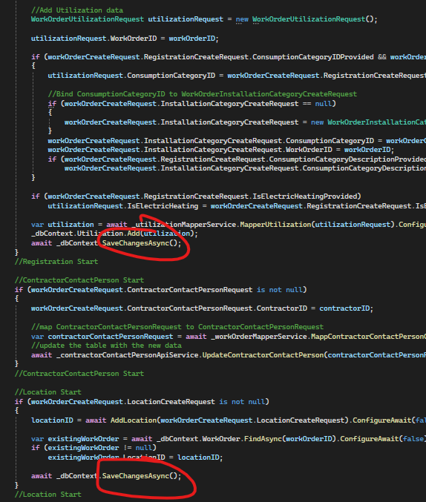
Unnecessary saves
Could affect performance
EF keeps tracks of changes, save at end instead

Slide 13
Too much mapping
FormModel
RequestModel
Hard to read
Hard to follow transitions
EntityModel
ResponseModel
IntegrationModel
FormModel
SonWinModel

Slide 14
Too much mapping – simplify?
FormModel
Simplify flow -> lesser transitions if possible
WorkOrderForm -> POST WorkOrderForm
EntityModel
FormModel

Slide 15
Duplicate endpoints?
WorkOrderSaveAsDraft – POST
UpdateWorkOrderSaveAsDraft – PATCH
CreateChargingStation – POST
SaveChargingStation – PATCH
BrokenMeterSealSaveAsDraft – POST
UpdateBrokenSealSaveAsDraft – PATCH
RequestDismantling – POST
SaveRequestDismantlingAsDraft – PATCH
Very similar logic in all endpoints
Redundant code, hard to maintain
Ideally, we could have ONE generic Post method and ONE generic Patch
CreateWorkOrder?
UpdateWorkOrder?

Slide 16
Further tips
MORE focus on code reviews and PR approvals
Follow coding guidelines:
https://medium.com/@hanxuyang0826/writing-clean-and-consistent-c-code-a-guide-to-net-code-conventions-d73f7418a661
Ask CoPilot/Claude/AI for guidance

